Slide 1
optimization

Slide 2




Functions and their optima
The objective function of the ML problem we are solving (e.g., squared loss for regression)
Assume unconstrained for now, i.e., just a real-valued number/vector
Many ML problems require us to optimize a function $f$ of some variable(s) $x$
For simplicity, assume $f$ is a scalar-valued function of a scalar $x$($f:$ $ℝ →ℝ)$
Any function has one/more optima (maxima, minima), and maybe saddle points
Finding the optima or saddles requires derivatives/gradients of the function
$$f(x)$$
A local maxima
A local maxima
Global maxima
Usually interested in global optima but often want to find local optima, too
A local minima
For deep learning models, often the local optima are what we can find (and they usually suffice) – more later
A local minima
A local minima
$$x$$
Will see what these are later
Global minima

Slide 3
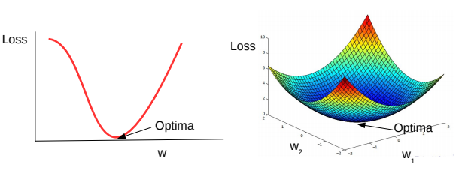
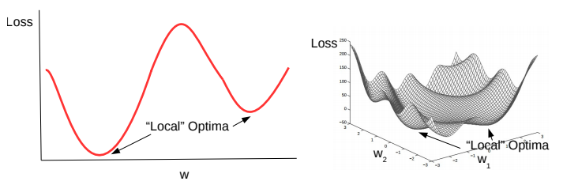
Convex and Non-Convex Functions
A function being optimized can be either convex or non-convex
Here are a couple of examples of convex functions
Here are a couple of examples of non-convex functions
Convex functions are bowl-shaped. They have a unique optima (minima)
Negative of a convex function is called a concave function, which also has a unique optima (maxima)
Non-convex functions have multiple minima. Usually harder to optimize as compared to convex functions
Loss functions of most deep learning models are non-convex

Slide 4
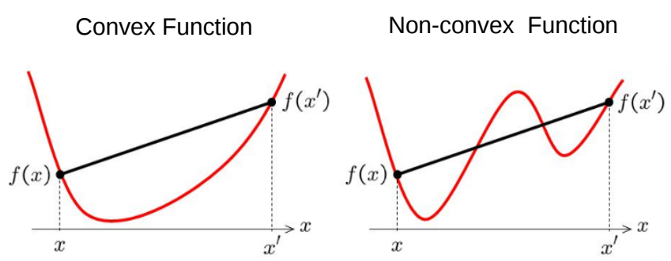

Convex Functions
Informally, $f(x)$ is convex if all of its chords lie above the function everywhere

Slide 5
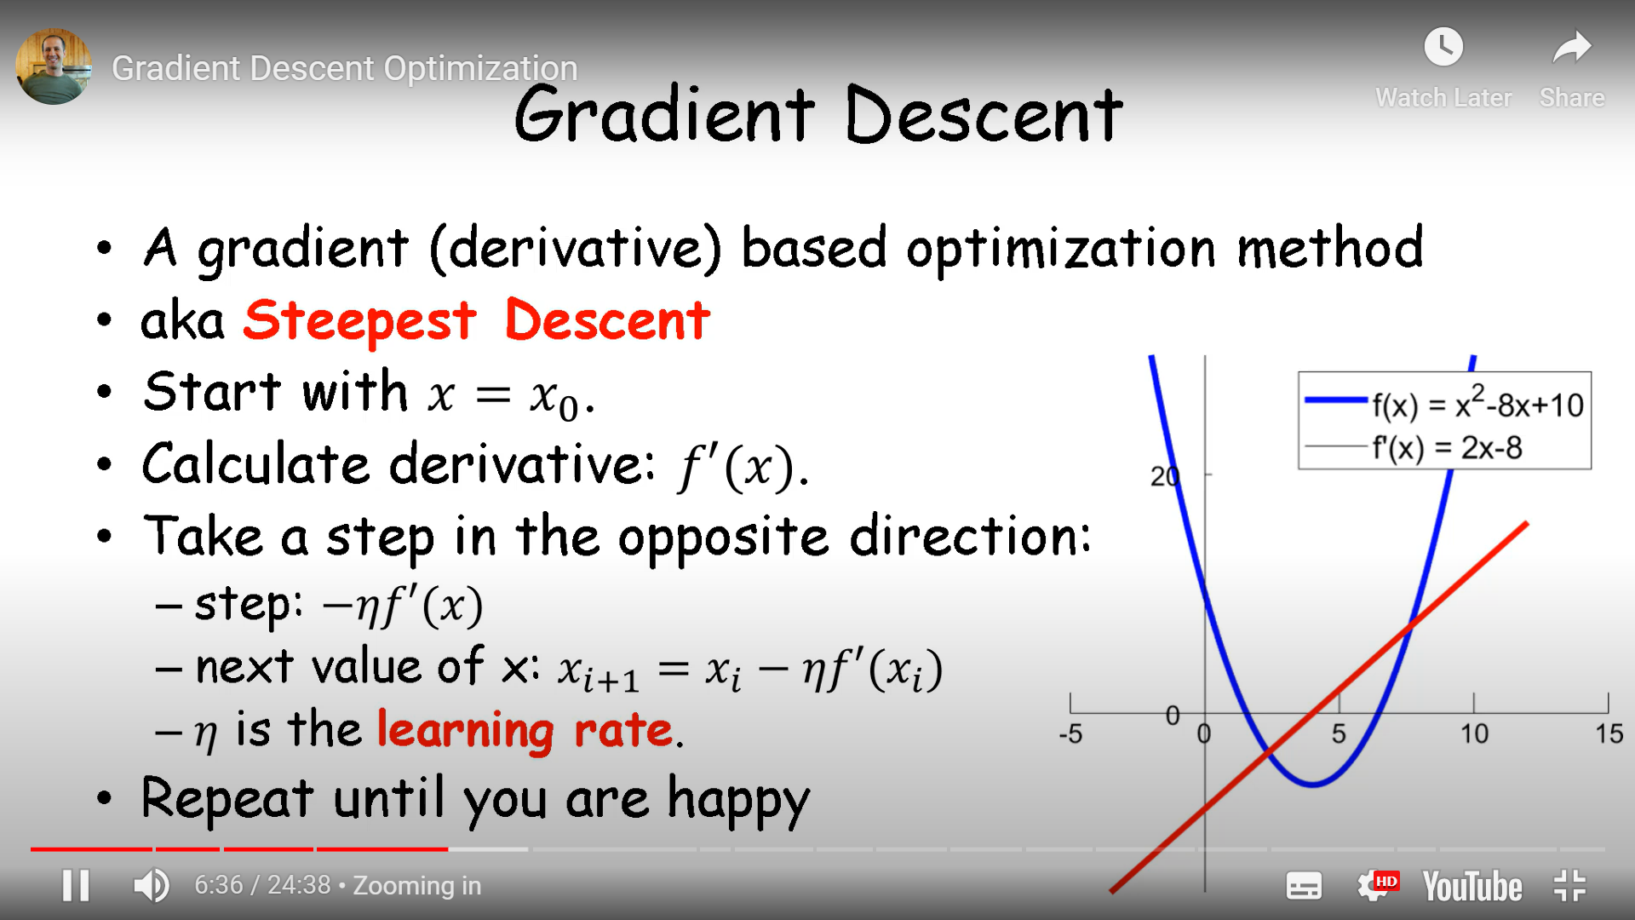

Slide 6
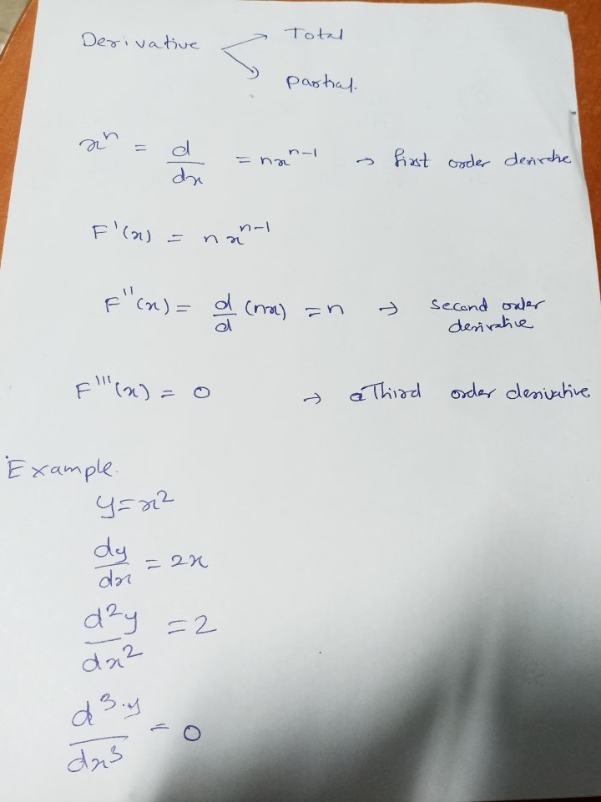

Slide 7
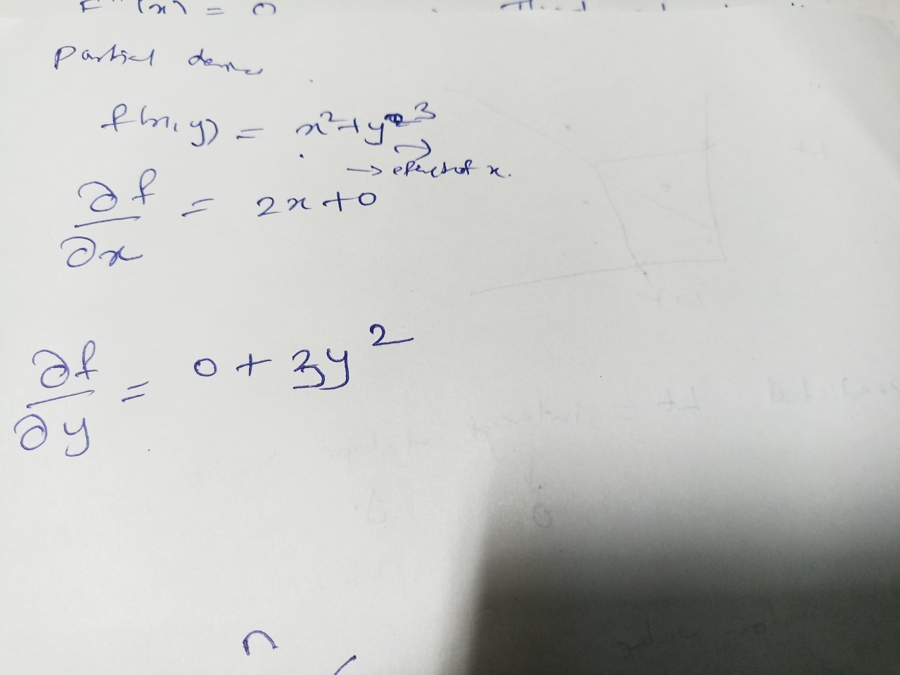

Slide 8
Consider the function f(x) = x^2 + 2x + 1. The goal is to find the value of x that minimizes this function using gradient descent.
Initialize the parameter: Let x=0 be the initial value.
Calculate the gradient: Compute the derivative of the function with respect to x:
f'(x) = 2x + 2
At x=0, f'(0) = 2.
Update the parameter: Move in the direction of the negative gradient by subtracting a small amount of the gradient from the current value of x. Let the learning rate be 0.1.
x_new = x - learning_rate * f'(x) = 0 - 0.1 * 2 = -0.2

Slide 9
Repeat: Calculate the gradient and update the value of x until convergence is achieved. Let's repeat the above steps for a few iterations:
Iteration 2:
f'(x) = 2(-0.2) + 2 = 1.6
x_new = 0 - 0.1 * 1.6 = -0.36
Iteration 3:
f'(x) = 2(-0.36) + 2 = 1.28
x_new = 0 - 0.1 * 1.28 = -0.488
Iteration 4:
f'(x) = 2(-0.488) + 2 = 0.976
x_new = 0 - 0.1 * 0.976 = -0.5856
Continue iterating until the change in the objective function is below a certain threshold or a maximum number of iterations is reached.
In this case, the minimum of the function is at x=-1, which is close to the value obtained by the gradient descent algorithm.

Slide 10
What is the gradient
The gradient is often used in optimization algorithms, such as Gradient Descent and its variations, to update the parameters of a machine learning model in the direction that minimizes a cost function. By computing the gradient of the cost function with respect to the model parameters, we can determine how to adjust the parameters to reduce the cost and improve the model's performance.
In traditional Gradient Descent, the algorithm calculates the gradient of the cost function with respect to all training examples at each iteration. However, as the size of the training set increases, this approach can become computationally expensive and slow. This is where SGD and MBGD come in, offering faster and more efficient optimization.

Slide 11
Stochastic Gradient Descent (SGD)
Stochastic Gradient Descent (SGD): SGD updates the model parameters after evaluating the cost function for each individual training example.
for each iteration, SGD randomly selects a single training example and calculates the gradient of the cost function for that example only.
The parameters are then updated based on this gradient.
SGD can be more efficient than traditional Gradient Descent, especially for large datasets, but it can also be more noisy since the updates are based on only one example at a time.

Slide 12
Stochastic Gradient Descent (SGD)
example of Stochastic Gradient Descent (SGD) in action:
Let's say we have a dataset of 1000 examples, where each example has two features, x1 and x2, and a target variable y. Our goal is to train a linear regression model to predict y based on x1 and x2.
We start by defining our cost function, which in this case is the
Mean Squared Error (MSE):
MSE = (1/n) * Σ(y_true - y_pred)^2
where n is the number of training examples, y_true is the true target value, and y_pred is the predicted target value.

Slide 13
Next, we initialize our model parameters, which in this case are the weights w1 and w2 and the bias b:
w1 = 0
w2 = 0
b = 0
We also set our learning rate, which controls the size of the parameter updates:
learning_rate = 0.01
Now, we can start the training process. In each iteration, we randomly select a single training example and update the parameters based on the gradient of the cost function for that example only. The update rule for SGD is:
w1 = w1 - learning_rate * (y_pred - y_true) * x1
w2 = w2 - learning_rate * (y_pred - y_true) * x2
b = b - learning_rate * (y_pred - y_true)
where x1 and x2 are the features of the selected example, and y_pred is the predicted target value based on the current parameter values.
We repeat this process for a fixed number of iterations or until the cost function converges to a satisfactory level.

Slide 14
Stochastic Gradient Descent (SGD)
Suppose we have the following dataset consisting of 5 samples
x | y
1 | 3
2 | 5
3 | 7
4 | 9
5 | 11
linear regression model as follows:
y = w * x + b
where w is the weight parameter and b is the bias parameter.
The update rule for SGD can be written as:
w = w - learning_rate * gradient_w
b = b - learning_rate * gradient_b
Initialize the weight parameter w and bias parameter b to small random values, say w = 0.5 and b = 0.1.
Select a random sample from the dataset, say (x=2, y=5).
Calculate the predicted value y_pred using the current values of w and b: y_pred = 0.5 * 2 + 0.1 = 1.2.
Compute the gradient of the loss function with respect to w and b using the selected sample: gradient_w = 2 * (y_pred - y_actual) * x = 2 * (1.2 - 5) * 2 = -5.6,
gradient_b = 2 * (y_pred - y_actual) = 2 * (1.2 - 5) = -7.6.
Update the values of w and b using the gradient and learning rate hyperparameter, say learning_rate = 0.01: w = 0.5 - 0.01 * (-5.6) = 0.556, b = 0.1 - 0.01 * (-7.6) = 0.178.
Repeat steps 2-5 for a fixed number of iterations or until the loss function converges to a minimum.

Slide 15
Mini-Batch Gradient Descent (MBGD)
MBGD updates the model parameters after evaluating the cost function for a small randomly selected batch of training examples.
In other words, for each iteration, MBGD selects a subset of the training data (usually between 10 and 1000 examples) and calculates the gradient of the cost function for that subset.
The parameters are then updated based on the average gradient across the subset.
This approach strikes a balance between the computational efficiency of SGD and the stability of traditional Gradient Descent, making it a popular choice for many machine learning tasks.

Slide 16
Momentum-based Gradient Descent (MGD
Momentum-based Gradient Descent (MGD) is a variation of Gradient Descent that helps accelerate convergence and improve stability during the optimization process.
In traditional Gradient Descent, the update rule for the parameters at each iteration is based solely on the gradient of the cost function with respect to the parameters. However, in MGD, we also introduce a momentum term that accumulates the gradients over time and helps to smooth out the updates and prevent oscillations in the optimization process.
The update rule for MGD can be written as:
v = βv + (1-β)∇J(θ) θ = θ – αv
where θ is the vector of parameters, ∇J(θ) is the gradient of the cost function with respect to θ, α is the learning rate, β is the momentum parameter (usually set to a value between 0.9 and 0.99), and v is the velocity vector.

Slide 17
Momentum-based Gradient Descent (MGD
At each iteration, we calculate the gradient of the cost function with respect to the parameters and update the velocity vector v by taking a weighted average of the previous velocity and the current gradient. The new parameters θ are then updated based on the velocity vector and the learning rate.
Introducing momentum helps MGD to build up velocity in directions where the gradients consistently point, and dampens the oscillations that occur in directions where the gradients vary in sign or magnitude. This can lead to faster convergence and more stable optimization, especially when the cost function is noisy or has a lot of curvatures.
Overall, MGD is a powerful optimization algorithm that can help improve the performance of machine learning models by accelerating convergence and improving stability.

Slide 18
We have a dataset of 5 samples with the following values
x | y
1 | 2
2 | 4
3 | 6
4 | 8
5 | 10
Our goal is to minimize the mean squared error (MSE) loss function:
L = 1/5 * (y_pred - y)^2
where y_pred is the predicted value of y based on the current values of the slope and intercept.
The MGD algorithm involves maintaining a momentum variable v, which is a moving average of the gradients of the loss function with respect to the parameters. The update rule for the parameters becomes:
w = w - lr * v_w
b = b - lr * v_b
where lr is the learning rate hyperparameter, v_w and v_b are the momentum variables for the slope and intercept respectively, and w and b are the current values of the slope and intercept.

Slide 19
Let's initialize the parameters and momentum variables as follows:
w = 0.5 b = 0.5 v_w = 0 v_b = 0
We will use a learning rate of 0.1 and a momentum coefficient of 0.9 (i.e., the momentum variable will be a weighted average of the current gradient and the previous momentum, with a weight of 0.9 given to the previous momentum).
Select a batch of size 1 from the dataset at random. Suppose we select the first sample (x=1, y=2).
Compute the gradient of the loss function with respect to the parameters using this sample:
y_pred = wx + b = 0.51 + 0.5 = 1
dL_dw = 2/5 * (y_pred - y) * x = 2/5 * (1 - 2) * 1 = -0.4
dL_db = 2/5 * (y_pred - y) * 1 = 2/5 * (1 - 2) * 1 = -0.4
Update the momentum variables using the current gradients and the momentum coefficient:
v_w = 0.9v_w - 0.1dL_dw = 0 - 0.1*(-0.4) = 0.04
v_b = 0.9v_b - 0.1dL_db = 0 - 0.1*(-0.4) = 0.04
Update the parameters using the momentum variables and the learning rate:
w = w + v_w = 0.5 + 0.04 = 0.54
b = b + v_b = 0.5 + 0.04 = 0.54

Slide 20
Repeat steps 1-4 for a few more epochs until the parameters converge to their optimal values.
After several epochs, the MGD algorithm should converge to a slope of 2 and an intercept of 0, which is the true solution for this linear regression problem. Note that MGD can converge faster than regular SGD, especially when the loss landscape is rugged or the learning rate is low.

Slide 21
Nesterov Accelerated Gradient Descent (NAG)
Nesterov Accelerated Gradient Descent (NAG) is a modification of the standard Momentum-based Gradient Descent algorithm that further improves the convergence rate of the optimization process.
In traditional MGD, the velocity vector is computed using the current gradient, which can cause the velocity vector to overshoot the optimal parameters when the current gradient is not representative of the true direction of the cost function. This can result in oscillations and slower convergence.

Slide 22
Nesterov Accelerated Gradient Descent (NAG)
NAG addresses this issue by updating the velocity vector using a "look-ahead" gradient, which estimates the gradient at the next step based on the current velocity vector.
The update rule for NAG can be written as:
v = βv + (1-β)∇J(θ - βv) θ = θ – αv
where θ is the vector of parameters, ∇J(θ - βv) is the look-ahead gradient, α is the learning rate, β is the momentum parameter, and v is the velocity vector.
The look-ahead gradient allows NAG to anticipate the next direction of the cost function and adjust the velocity vector accordingly. This can lead to faster convergence and more accurate parameter estimates compared to traditional MGD.

Slide 23
AdaGrad (Adaptive Gradient)
AdaGrad (Adaptive Gradient) is a gradient descent optimization algorithm that adapts the learning rate of each parameter based on the historical gradient information.
The basic idea of AdaGrad is to use a different learning rate for each parameter, which is adapted during the training process.
The learning rate is decreased for frequently occurring features and increased for infrequent features, which can improve the performance of the model.

Slide 24
The AdaGrad algorithm can be summarized in the following steps:
Initialize the weight vector w and the gradient sum G to zero.
For each iteration t:
a. Compute the gradient gt of the loss function with respect to the weight w(t).
b. Add the squared gradient gt^2 to the diagonal of G.
c. Compute the update vector δt as: δt = (η / √(Gt + ε)) * gt
d. Update the weight vector as: w(t+1) = w(t) - δt

Slide 25
One advantage of AdaGrad is that it does not require a manual tuning of the learning rate, as the learning rate is automatically adjusted based on the historical gradient information. However, one disadvantage is that the learning rate can become too small over time, which can lead to slow convergence or premature stopping of the algorithm.

Slide 26
Regularization
Regularization is a technique used in machine learning to prevent overfitting of a model.
Overfitting occurs when a model is too complex and fits the training data too closely, resulting in poor performance on new, unseen data.
Regularization adds a penalty term to the loss function of a model, which discourages the model from learning overly complex patterns in the data.
There are several types of regularization techniques
L1 regularization (also known as Lasso)
L2 regularization (also known as Ridge)
Elastic Net regularization.
L1 regularization adds a penalty term to the loss function that is proportional to the absolute value of the model weights,
L2 regularization adds a penalty term that is proportional to the square of the model weights.
Elastic Net regularization is a combination of L1 and L2 regularization

Slide 27
L1 regularization
L1 regularization, also known as Lasso regularization, is a technique used in machine learning to prevent overfitting by adding a penalty term to the loss function of a model.
The penalty term is proportional to the absolute value of the model weights, which encourages the model to learn sparse representations of the data.
L1 regularization, the loss function of a model is modified by adding a regularization term multiplied by a hyperparameter lambda.
The regularization term is the sum of the absolute values of the model weights, also known as the L1 norm.
The resulting optimization problem is to minimize the sum of the squared errors between the predicted and actual values, subject to the constraint that the sum of the absolute values of the model weights is less than or equal to lambda.

Slide 28
Let's say we have a linear regression model with a set of features X1, X2, X3, and X4 to predict the price of a house. The coefficients of the model are represented by w1, w2, w3, and w4 respectively.
The model can be written as:
y = w1X1 + w2X2 + w3X3 + w4X4 + b
where y is the predicted price and b is the bias term.
To prevent overfitting, we can add L1 regularization to the loss function of the model. The loss function with L1 regularization is:
L = (1/N)sum((y_pred - y_true)^2) + lambdasum(|wi|)
where N is the number of samples, y_pred is the predicted value, and y_true is the true value.
The second term in the loss function is the L1 regularization term. The hyperparameter lambda controls the strength of the regularization.
During training, the model will learn the values of w1, w2, w3, and w4 that minimize the loss function subject to the L1 regularization constraint. The effect of the L1 regularization is to encourage the model to learn sparse weights, which can lead to some of the coefficients being set to zero. This has the effect of selecting the most important features for the prediction task and reducing the complexity of the model.
For example, if the L1 regularization sets w3 to zero, it means that the feature X3 is not important for the prediction task and can be removed from the model.

Slide 29
x = [1, 2, 3, 4, 5]
y_true = [2, 4, 6, 8, 10]
We initialize the weights as w0 = 0.5 and w1 = 0.5, and set lambda = 0.1.
After training the model, we obtain the following values of the weights:
w0 = 0.676 and w1 = 1.339
To apply the L1 regularization penalty, we take the absolute values of the weights and sum them:
|w0| + |w1| = |0.676| + |1.339| = 2.015
We then multiply this sum by the regularization parameter lambda and add it to the original loss function:
L = (1/5) * sum((y_pred - y_true)^2) + 0.1 * 2.015
Finally, we optimize the loss function with respect to the weights using gradient descent or some other optimization algorithm.
Note that the L1 regularization penalty encourages sparsity in the weights, which means that some of the weights may become exactly zero. In this example, it is possible that either w0 or w1 (or both) become zero, depending on the strength of the regularization and the size of the dataset

Slide 30
L2 regularization
L2 regularization, also known as Ridge regularization, The penalty term is proportional to the square of the model weights, which encourages the model to learn small weights.
In L2 regularization, the loss function of a model is modified by adding a regularization term multiplied by a hyperparameter lambda
The regularization term is the sum of the squared values of the model weights, also known as the L2 norm.
The effect of L2 regularization is to shrink the weights of all the features towards zero, but not necessarily to zero.
This has the effect of reducing the magnitude of the weights and reducing the complexity of the model.
The loss function with L2 regularization is:
L = (1/N)sum((y_pred - y_true)^2) + lambdasum(wi^2)

Slide 31
Difference between L1 and L2 regularization
The main difference between L1 and L2 regularization is the way they penalize the model weights.
L1 regularization encourages the model to learn sparse weights, while L2 regularization encourages the model to learn small weights. In addition, L1 regularization can lead to exact zeros in the model weights, while L2 regularization can only shrink the weights towards zero, but not necessarily to zero.
In practice, the choice between L1 and L2 regularization depends on the specific problem and the properties of the data. L1 regularization is preferred when the goal is to select only the most important features, while L2 regularization is preferred when dealing with highly correlated features.

